Slide 1
Session 4
Introduction to Web application (Servlets/JSP)
Introduction to Build Tools

Slide 2
Introduction to J2EE Web Application

Slide 3
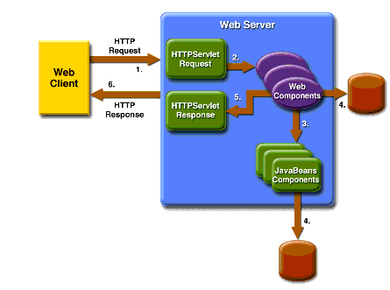
J2EE Web Application
1. Overview of J2EE Web Applications - Introduction to Java 2 Enterprise Edition (J2EE) - Key components of a J2EE web application
2. J2EE Web Application Architecture - Understanding the layered architecture - Role of presentation, business, and data access layers
3. J2EE Web Application Components - Servlets and JSPs - Web containers and their role

Slide 4
Overview of J2EE Web Applications:
Java 2 Enterprise Edition (J2EE) is a platform for building large-scale, distributed, and multi-tiered enterprise applications.
J2EE applications are designed to handle scalability, security, and reliability challenges that come with enterprise-level systems.

Slide 5
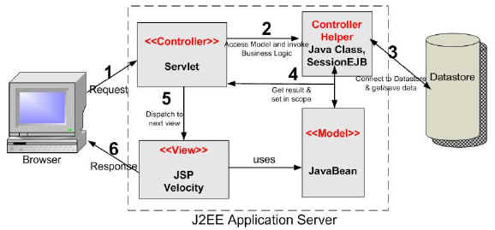
J2EE Web Application Architecture:
Layered Architecture: J2EE web applications follow a layered architecture: - Presentation/View Layer: Handles user interface and user interaction. - Business Logic Layer: Contains business logic and rules. - Data Access Layer: Manages data storage and retrieval.

Slide 6
J2EE Web Application Components:
Servlets: Java classes that handle HTTP requests and generate dynamic content. Servlets reside on the server-side and can respond to client requests, process data, and generate HTML or other formats.
JSPs (JavaServer Pages): Template-based technology for creating dynamic web content. JSPs allow embedding Java code within HTML, enabling the creation of dynamic web pages.
Web Containers: Also known as Servlet Containers, these are responsible for managing the execution of servlets and JSPs. They handle request/response processing, session management, and more.

Slide 7
Creating a J2EE Web Application Structure
1. Project Structure - Understanding the directory structure - Key folders and files 2. Creating a Simple Web Application - Setting up the project - Creating a basic servlet and JSP

Slide 8
Project Structure:
A typical J2EE web application has a well-defined directory structure: webapp/ |-- WEB-INF/ | |-- classes/ (Servlet class files) | |-- lib/ (JAR files) | |-- web.xml (Deployment descriptor) | |-- index.jsp (Welcome page)

Slide 9
Creating a Simple Web Application:
Setting Up the Project: Create a directory structure as shown above. Creating a Basic Servlet: 1. Create a Java class that extends `javax.servlet.http.HttpServlet`. 2. Override the `doGet` or `doPost` method to handle HTTP requests. Creating a Basic JSP: 1. Create an `.jsp` file within the `webapp` folder. 2. Add HTML content with embedded Java code using `<% %>` or JSTL (JavaServer Pages Standard Tag Library) tags.

Slide 10
Handling Requests and Responses
1. Request-Response Cycle - Understanding how web containers handle requests 2. Servlets: Handling Requests - Retrieving request parameters - Forwarding and redirecting requests 3. JSPs: Generating Responses - Embedding Java code in JSPs - Using JSTL tags for dynamic content

Slide 11
Request-Response Cycle:
A client sends an HTTP request to the server.
The web container processes the request.
Servlets or JSPs generate dynamic content.
The web container sends the response back to the client.

Slide 12
Servlets: Handling Requests:
Retrieving Request Parameters: - Accessing query parameters and form data using `request.getParameter()`
Forwarding and Redirecting Requests: - Forwarding: `request.getRequestDispatcher("path").forward(request, response);` - Redirecting: `response.sendRedirect("newURL");`

Slide 13
JSPs: Generating Responses:
Embedding Java Code in JSPs: - Using `<% %>` for scriptlets. - Using `<%= %>` for output expressions.
Using JSTL Tags for Dynamic Content: - Core tags for conditionals, loops, and formatting. - Using JSTL functions for string manipulation.

Slide 14
Managing State and Sessions
1. HTTP Statelessness and Challenges - Understanding statelessness in web applications 2. Cookies and Sessions - Using cookies for client-side state - Managing sessions on the server side

Slide 15
Deployment and Configuration
1. Deployment Descriptor (web.xml) - Role and structure of the deployment descriptor
- Configuration file for the web application. - Defines servlets, filters, listeners, error pages, etc.
2. Web Application Deployment - Packaging the web application - Deploying to a web container

Slide 16
Web Application Deployment:
Packaging the Web Application: - Packaging the content into a WAR (Web Archive) file. - Including compiled classes, JSPs, resources, and the deployment descriptor.
Deploying to a Web Container: - Copying the WAR file to the web container's deployment directory. - Automatic deployment and initialization by the container.

Slide 17
Create a Dynamic Web Project
You need to have Eclipse IDE and a compatible servlet container (e.g., Apache Tomcat) installed and configured in Eclipse before proceeding with this example.
Step 1: Create a Dynamic Web Project 1. Open Eclipse. 2. Go to `File` > `New` > `Dynamic Web Project`. 3. Name the project (e.g., "ServletJSPExample") and click `Next`. 4. Configure the project settings as needed and click `Finish`.
Step 2: Create a Servlet 1. Right-click on the project in the Project Explorer. 2. Go to `New` > `Servlet`. 3. Enter the servlet name (e.g., "HelloServlet") and package name (e.g., "com.example"). 4. Click `Next`, and then select "Generate web.xml deployment descriptor" and click `Next`. 5. Click `Finish`.

Slide 18
Create Servlet
3. Replace the content of `HelloServlet.java` with the following code: package com.bri8; import jakarta.servlet.ServletException;
import jakarta.servlet.http.HttpServlet;
import jakarta.servlet.http.HttpServletRequest;
import jakarta.servlet.http.HttpServletResponse;
import java.io.IOException;
public class HelloServlet extends HttpServlet { protected void doGet(HttpServletRequest request, HttpServletResponse response) throws ServletException, IOException { String name = request.getParameter("name");
response.getWriter().println("Hello from the Servlet : " + name);
} }

Slide 19
Create JSP
Step 4: Create a JSP 1. Right-click on the `WebContent` folder in the Project Explorer. 2. Go to `New` > `File`. 3. Enter the JSP name (e.g., "hello.jsp") and click `Finish`. Replace the content of `hello.jsp` with the following code: jsp <!DOCTYPE html> <html> <head> <title>Hello JSP</title> </head> <body> <h1><%= "Hello from the JSP!" %></h1> </body> </html>

Slide 20
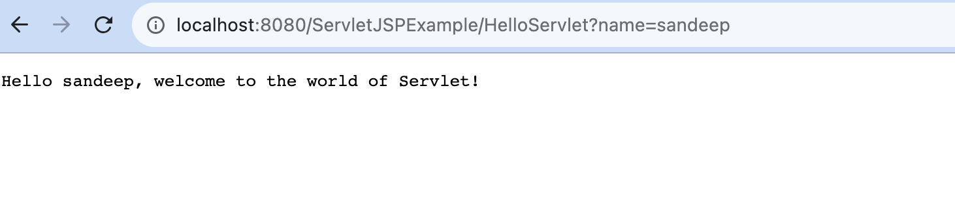
Deploy
Step 4: Deploy and Run 1. Right-click on the project in the Project Explorer. 2. Go to `Run As` > `Run on Server`. 3. Select your configured server (e.g., Apache Tomcat) and click `Finish`.
Your browser should open, and you'll see the output from both the Servlet and the JSP: From the Servlet: "Hello from the Servlet!" From the JSP: "Hello from the JSP!" Congratulations! You've successfully created and deployed a simple Servlet-JSP application using Eclipse.

Slide 21
Introduction to Build Tools

Slide 22
Agenda:
1. Understanding the need for Build Tools - Definition and importance of Build Tools - Challenges in manual build processes
2. Introduction to Apache Ant - Overview of Apache Ant - Writing a Simple Build File
3. Introduction to Maven - What is Maven? - Maven's features and benefits
4. Maven Terminology - Project, Artifact, Dependency, Repository, POM (Project Object Model)

Slide 23
1. Understanding the Need for Build Tools:
Build tools are essential in software development to automate the process of compiling, testing, and packaging code into executable artifacts.
Manual build processes can be error-prone, time-consuming, and difficult to reproduce across different environments.
Challenges of manual builds:
Inconsistent build environments
Manual dependency management
Time-consuming compilation and packaging
Lack of automation for testing and deployment

Slide 24
- Overview of Apache Ant - Writing a Simple Build File - Defining Targets and Tasks - Executing Builds with Ant
2. Introduction to Apache Ant
<project name="WebAppBuild" default="build" basedir=".">
<!-- Define properties -->
<property name="src.dir" value="src" />
<property name="build.dir" value="build" />
<property name="web.dir" value="${build.dir}/web" />
<property name="web.inf.dir" value="${web.dir}/WEB-INF" />
<property name="classes.dir" value="${web.inf.dir}/classes" />
<property name="lib.dir" value="${web.inf.dir}/lib" />
<property name="war.file" value="MyWebApp.war" />
<!-- Create necessary directories -->
<target name="init">
<mkdir dir="${web.inf.dir}" />
<mkdir dir="${classes.dir}" />
<mkdir dir="${lib.dir}" />
</target>
<!-- Compile Java source files -->
<target name="compile" depends="init">
<javac srcdir="${src.dir}" destdir="${classes.dir}" />
</target>
<!-- Copy resources -->
<target name="copy-resources" depends="compile">
<copy todir="${web.dir}">
<fileset dir="${src.dir}" excludes="**/*.java" />
</copy>
</target>
<!-- Build WAR file -->
<target name="war" depends="copy-resources">
<war destfile="${war.file}" webxml="${web.inf.dir}/web.xml">
<fileset dir="${web.dir}" />
<lib dir="${lib.dir}" />
<classes dir="${classes.dir}" />
</war>
</target>
<!-- Clean build artifacts -->
<target name="clean">
<delete dir="${build.dir}" />
<delete file="${war.file}" />
</target>
<!-- Default target -->
<target name="build" depends="war" />
</project>

Slide 25
3. Introduction to Maven:
Maven is a widely used build automation and project management tool that simplifies and automates the software build process.
It provides a standard way to manage projects, dependencies, and builds across different environments.
Features and benefits of Maven:
Dependency Management: Maven automatically resolves and manages project dependencies.
Consistent Builds: Ensures consistent builds across different environments and team members.
Project Lifecycle Management: Defines a standard project lifecycle (clean, compile, test, package, install, deploy).
Convention over Configuration: Uses a standardized project structure, reducing configuration overhead.
Plug-in Architecture: Extensible through various plugins for different tasks.

Slide 26
4. Maven Terminology:
Project: A software project that is managed and built using Maven. Artifact: A packaged, versioned binary or archive, such as a JAR, WAR, or EAR file. Dependency: An external library or module required by the project. Repository: A centralized location to store and retrieve project artifacts and dependencies. POM (Project Object Model): An XML file that defines the project's configuration, dependencies, and plugins.

Slide 27
4. Setting Up Maven and Creating a Project
1. Installing Maven - Downloading and installing Maven - Setting up environment variables 2. Creating a Maven Project - Using Maven Archetypes - Understanding the project structure 3. Configuring Project Information - Editing the POM (Project Object Model)

Slide 28
1. Installing Maven:
Download Maven from the official website (https://maven.apache.org/download.cgi). Installation instructions for different operating systems (Windows, macOS, Linux). Setting up environment variables (`PATH` and `M2_HOME`).

Slide 29
2. Creating a Maven Project:
<?xml version="1.0" encoding="UTF-8"?>
<project xmlns="http://maven.apache.org/POM/4.0.0"
xmlns:xsi="http://www.w3.org/2001/XMLSchema-instance"
xsi:schemaLocation="http://maven.apache.org/POM/4.0.0 http://maven.apache.org/xsd/maven-4.0.0.xsd">
<modelVersion>4.0.0</modelVersion>
<groupId>com.example</groupId>
<artifactId>ServletJSPExample</artifactId>
<version>1.0-SNAPSHOT</version>
<properties>
<maven.compiler.source>1.8</maven.compiler.source>
<maven.compiler.target>1.8</maven.compiler.target>
</properties>
<dependencies>
<!-- Servlet API -->
<dependency>
<groupId>javax.servlet</groupId>
<artifactId>javax.servlet-api</artifactId>
<version>4.0.1</version>
<scope>provided</scope>
</dependency>
</dependencies>
<build>
<plugins>
<!-- Maven Compiler Plugin -->
<plugin>
<groupId>org.apache.maven.plugins</groupId>
<artifactId>maven-compiler-plugin</artifactId>
<version>3.8.1</version>
<configuration>
<source>${maven.compiler.source}</source>
<target>${maven.compiler.target}</target>
</configuration>
</plugin>
<!-- Maven War Plugin -->
<plugin>
<groupId>org.apache.maven.plugins</groupId>
<artifactId>maven-war-plugin</artifactId>
<version>3.2.3</version>
<configuration>
<warName>MyWebApp</warName>
</configuration>
</plugin>
</plugins>
</build>
</project>
To use this pom.xml file:
Save the file as pom.xml in the root directory of your web application project.
Make sure that your project's source code is in the src/main/java directory.
Run mvn clean install from the command line in the project's root directory. This will compile your source code, package it into a WAR file, and place the WAR file in the target directory.
This example uses the Maven Compiler Plugin to set the Java version and the Maven War Plugin to package the application into a WAR file. The Servlet API dependency is included with a provided scope, indicating that the servlet container will provide the actual implementation of the API at runtime.

Slide 30
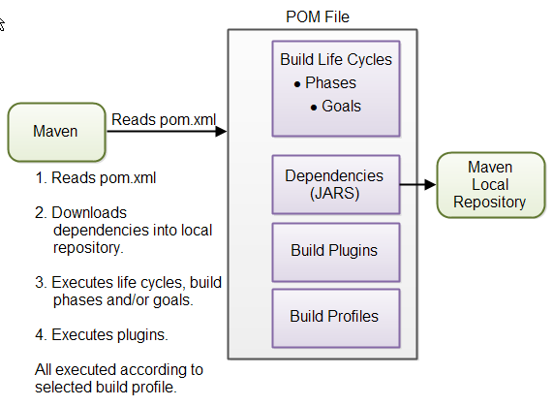
3. Configuring Project Information:
Introduction to the POM (Project Object Model) XML file. Configuring project metadata: `groupId`, `artifactId`, `version`. Adding project dependencies to the POM. Specifying the build lifecycle phases in the POM.

Slide 31
5. Building and Managing Dependencies with Maven
1. Maven Build Lifecycle - Overview of the standard build phases 2. Building the Project - Executing the build lifecycle phases 3. Managing Dependencies - Adding dependencies to the POM - Understanding transitive dependencies

Slide 32
Maven Build Lifecycle:
Overview of the Maven build lifecycle: `clean`, `validate`, `compile`, `test`, `package`, `install`, `deploy`. Explanation of each phase's purpose and tasks.

Slide 33
Building the Project:
Running build lifecycle phases using the `mvn` command. Demonstrating different build goals (e.g., `mvn clean`, `mvn compile`, `mvn install`).

Slide 34
Managing Dependencies:
Adding dependencies to the POM using the `<dependencies>` section. Specifying dependencies with `groupId`, `artifactId`, and `version`. Understanding transitive dependencies and how Maven resolves them.

Slide 35
Advanced Maven Concepts and Plugins
1. Maven Plugins - Introduction to plugins and their role 2. Customizing the Build - Configuring plugins in the POM - Running custom goals 3. Introduction to Maven Central Repository - Using Maven Central for retrieving dependencies

Slide 36
Keynotes
1. J2EE Overview:
- J2EE (Java 2 Enterprise Edition) is a platform developed by Sun Microsystems (now Oracle) to build large-scale, distributed, and multi-tiered enterprise applications.
- It provides a comprehensive set of APIs and services for building, deploying, and managing enterprise applications.
2. Web Application Basics:
- A web application is a software application that runs in a web browser. It's accessed over the internet or an intranet.
- Web applications provide interactive user interfaces, data processing, and often connect to databases and external services.
3. Components of a J2EE Web Application:
- J2EE web applications are designed using a multi-tiered architecture that separates different concerns:
- Presentation Layer: Deals with the user interface, often using HTML, CSS, and JavaScript.
- Business Logic Layer: Contains the application's business rules and logic.
- Data Access Layer: Handles data storage and retrieval from databases or other sources.
4. Key Components:
- Servlets: Java classes that handle HTTP requests and generate dynamic content on the server-side.
- JavaServer Pages (JSPs): Template-based technology for creating dynamic web content with embedded Java code.
- Web Containers: Also known as Servlet Containers, they provide the runtime environment for servlets and manage their lifecycle.
5. Advantages of J2EE Web Applications:
- Scalability: J2EE applications are designed to handle high levels of traffic and users.
- Security: J2EE provides security mechanisms for authentication, authorization, and data protection.
- Reliability: J2EE applications are built to be robust and fault-tolerant.
- Portability: J2EE applications can run on different platforms with compatible Java runtimes.
6. Development Process:
- Develop: Create servlets, JSPs, and other components using Java.
- Deploy: Package the application into a WAR (Web Archive) file.
- Deploy to a Web Container: Deploy the WAR file to a servlet container (e.g., Apache Tomcat) for execution.
7. Web Application Lifecycle:
- Initialization: Web container initializes servlets and other resources.
- Request Processing: Servlets process incoming requests, generate responses, and communicate with business logic.
- Destruction: Web container shuts down servlets and releases resources.
8. Web Application Deployment:
- A J2EE web application is packaged as a WAR file (similar to a JAR file for libraries).
- The WAR file contains servlet classes, JSPs, HTML, configuration files, and resources.
9. Key Technologies and APIs:
- Servlet API: Provides classes and interfaces for creating servlets.
- JavaServer Pages (JSP): Used to create dynamic web content.
- JavaBeans: Reusable components used to manage data and logic in web applications.
- Java Naming and Directory Interface (JNDI): Used to access naming and directory services.
- Java Database Connectivity (JDBC): Used for database connectivity.
- Enterprise JavaBeans (EJB): Component-based architecture for server-side business logic (Optional, not covered in this introduction).
10. Conclusion:
- J2EE web applications are a powerful way to build scalable, secure, and reliable enterprise-level applications.
- Understanding the architecture, components, and development process is essential for creating effective web applications.

Slide 37
Introduction to Build Tools and Maven
1. Build Process Overview:
- Software development involves various activities, including coding, testing, and deployment.
- The build process compiles, tests, and packages the source code into a deployable artifact (e.g., JAR, WAR).
2. Importance of Build Tools:
- Build tools automate and streamline the build process, reducing manual effort and ensuring consistency.
- They help manage dependencies, compile code, run tests, generate documentation, and package the application.
3. Common Build Tools:
- Ant: A popular build tool based on XML, widely used before the rise of more modern tools.
- Maven: A powerful and widely adopted build tool that emphasizes convention over configuration.
- Gradle: A flexible build tool that combines the best features of Ant and Maven, using a Groovy-based DSL.
4. Introduction to Maven:
- Maven is a widely used build tool in the Java ecosystem.
- It provides a structured approach to project management and builds automation.
5. Key Features of Maven:
- Project Object Model (POM): Maven uses a POM XML file to define project information, dependencies, and configurations.
- Convention Over Configuration: Maven follows a predefined project structure and naming conventions.
- Dependency Management: Maven simplifies the management of project dependencies, downloading and managing them automatically.
- Lifecycle and Goals: Maven defines a set of build phases (e.g., compile, test, package) with associated goals (tasks) for each phase.
- Plugins: Maven plugins provide additional functionality and can extend the build process.
6. Maven Terminology:
- Artifact: A deployable unit (e.g., JAR, WAR) produced by the build process.
- Repository: A centralized location for storing and sharing artifacts.
- Group ID: Identifies a group or organization that the project belongs to.
- Artifact ID: Specifies the project's unique identifier within the group.
- Version: Represents the version of the artifact.
7. Maven Build Lifecycle:
- Maven has a predefined build lifecycle consisting of phases.
- Example phases: clean, validate, compile, test, package, install, deploy.
- Goals associated with each phase are executed in sequence.
8. Maven Project Structure:
- Maven follows a standard directory structure:
- src/ main/ java
| |- resources
|- test
| |- java
| |- resources
|- pom.xml
9. Dependency Management with Maven:
- Dependencies are defined in the POM.
- Maven automatically downloads required dependencies from repositories.
- Transitive dependencies are resolved automatically.
10. Running Maven Commands:
- Use the mvn command to execute Maven goals.
- Example commands: mvn clean, mvn compile, mvn test, mvn package, mvn install.
11. Conclusion:
- Build tools like Maven are essential for automating and managing the software build process.
- Maven simplifies project management, dependency handling, and build automation, making development more efficient and consistent.

